Slide 1

Integrated Project on File Sharing application
Team Members (GB_15)
Swapnil (Y, 1811981319)
Amardeep(Y, 1811981040)
Ansh (Y, 1811981056)
Soumyadeep(W, 1811981308)

Slide 2
Technologies Used
Frontend Technologies
BACKEND TECHNOLOGIES
HTML
CSS
JAVASCRIPT
REACT JS
Java
SpringBoot

Slide 3
Insights about IP Project
Time taken to complete the Project –75 hours
Editors used for Frontend and Backend:-IntellijIdea/Visual Studio
Github Repo Link - https://github.com/Swapnil-20/File-Uploader

Slide 4

Key Features
User Sign up/ Login
File upload/download
Crop images
File preview

Slide 5
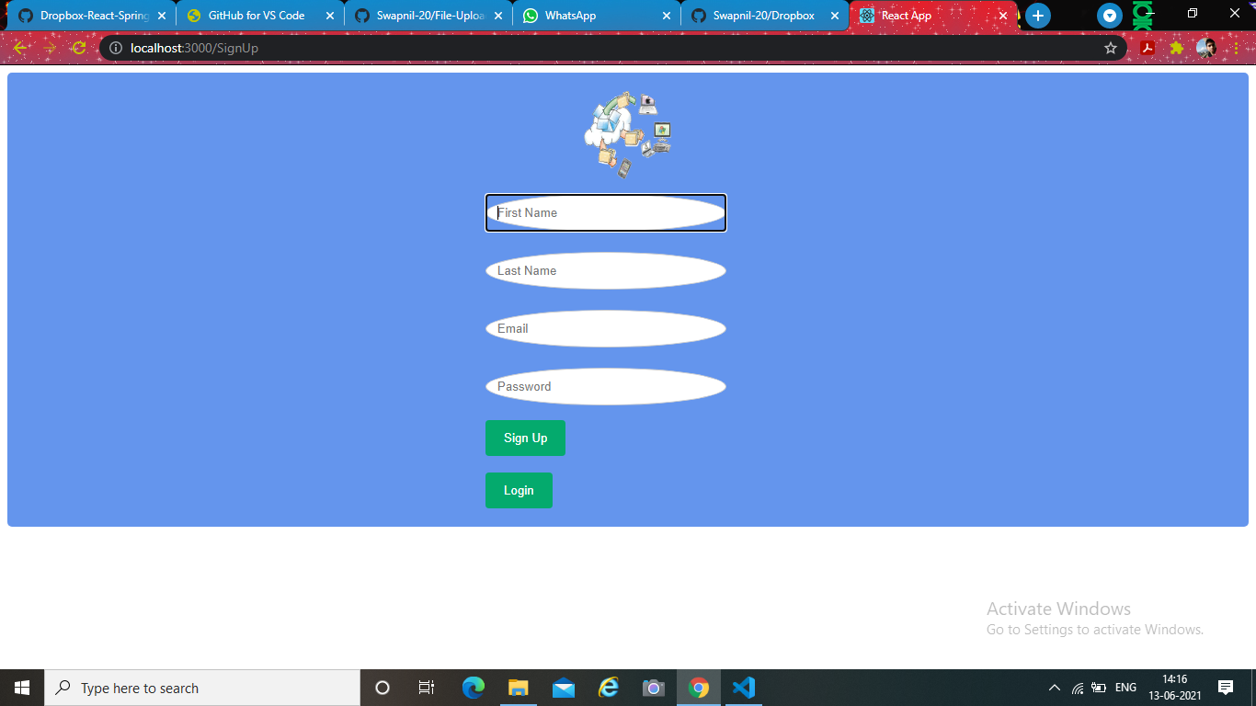
SignUp:-

Slide 6
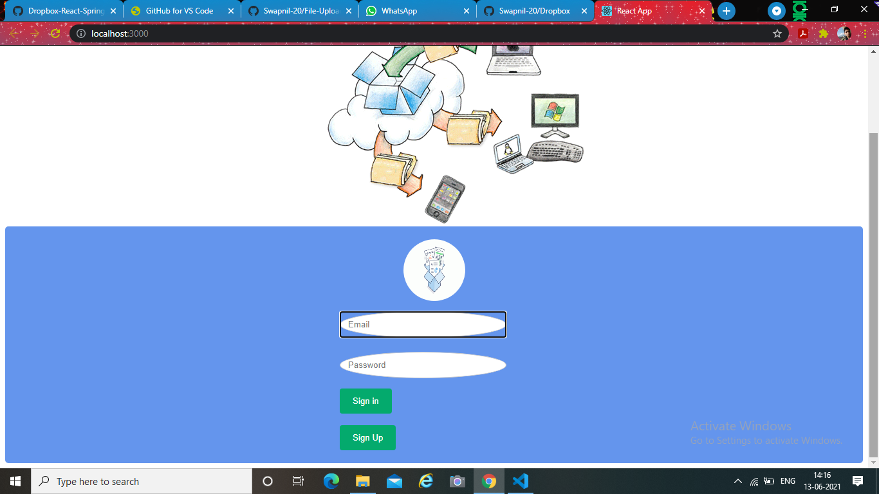
Login:-

Slide 7
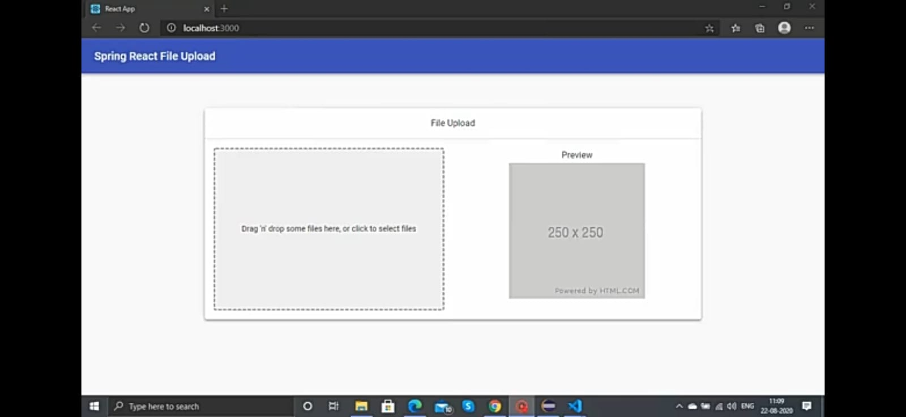
Drag n Drop:-

Slide 8
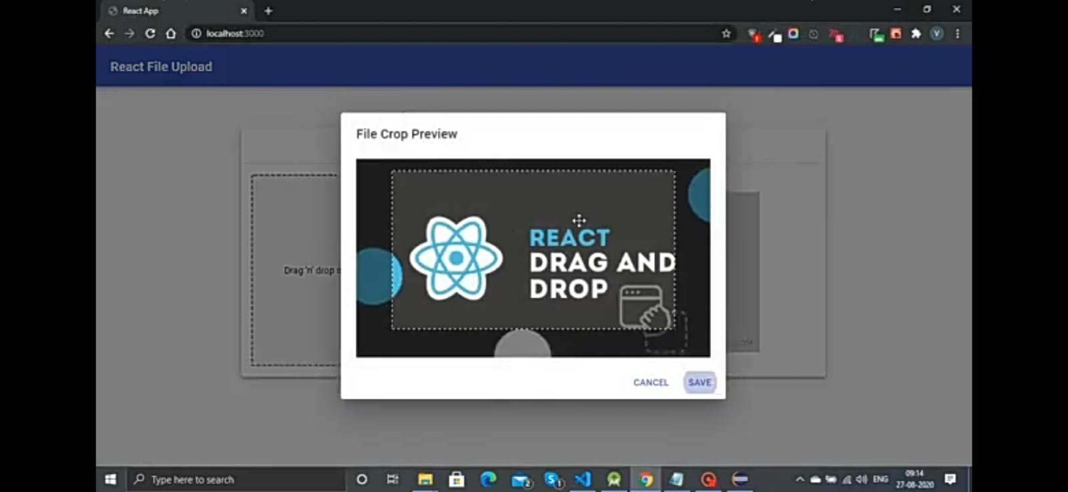
Crop Feature:-

Slide 9
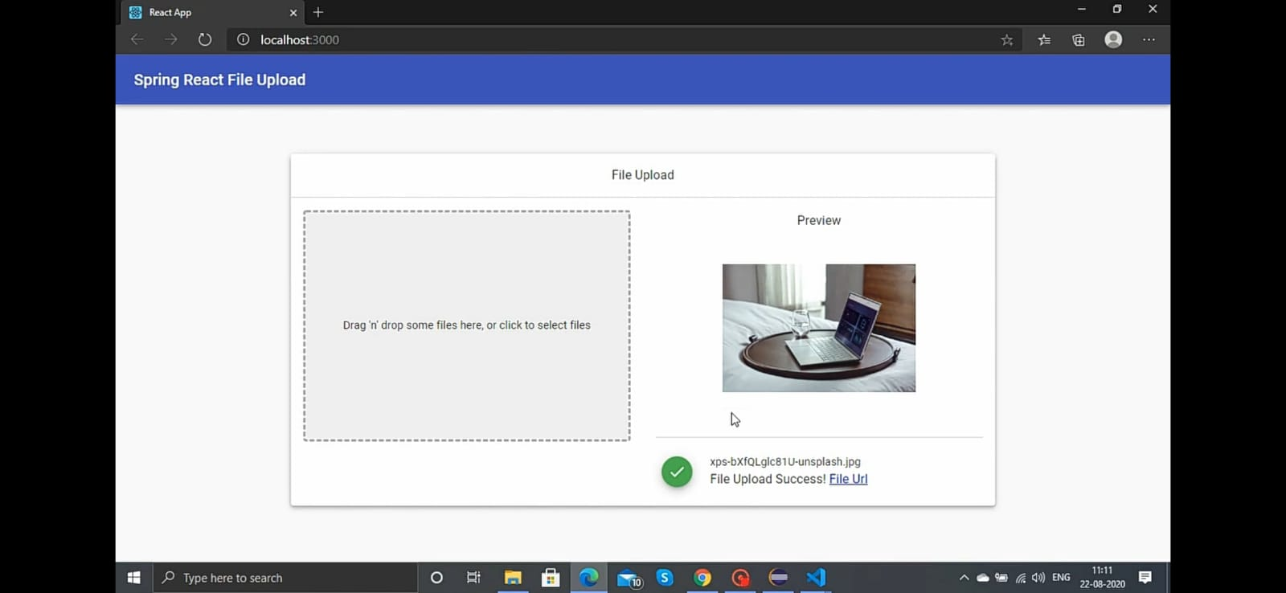
File Upload:-

Slide 10
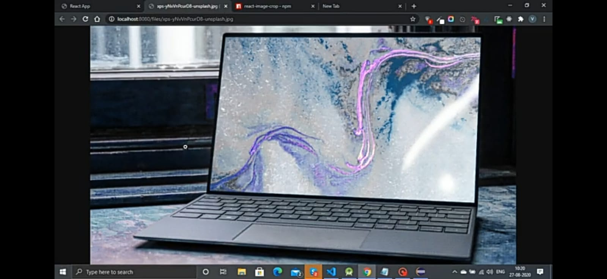
Final Preview:-

